Slide 1


AZAD INSTITUTE OF ENGINEERING AND TECHNOLOGY
DEPARTMENT OF COMPUTER SCIENCE ENGINEERING
Guided By :- Mr. AP Singh
(Assistant Officer)
(Department of Computer Science And Engineering)
Presented By :- Nisha
(B.Tech IV year)
1605310025

Slide 2


AGE & GENDER PREDICTION

Slide 3

Content
OBJECTIVE
STATEMENT OF PROBLEM
TERMINOLOGIES
METHODOLOGY
TECHNOLOGY
PROJECT VIEW
SCOPE IN FUTURE
APPLICATIONS
LIMITATIONS
CONCLUSION

Slide 4

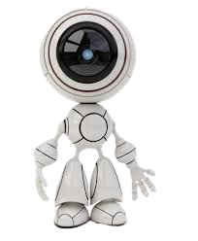
OBJECTIVE
The objective of this project is to built a predictive app which predicts the gender and age of a person by just capturing its face or a picture using deep learning.

Slide 5
RIGID ANATOMY
ACCESSORIES
01
02
03
EDITED IMAGES
05
PHYSICAL FACTORS
STATEMENT PROBLEM
Artificial Accessories, Makeup, Spectacles, Goggles, Hats and Caps etc.
All faces have the approx. same structure challenging to recognize
Different filters poses and features editing can affect the result
GENITICS
04
Medical problems, Harsh working conditions, plastic surgeries
Some people get old faster.

Slide 6

TERMINOLOGIES
Computer vision
OpenCV
CNN
Deep learning
Provides the computer ability to see.
Commonly applied for analysing visual imagery.
Subset of machine learning in artificial intelligence (AI)
For processing real-time image and video.

Slide 7
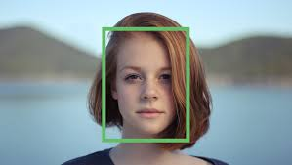
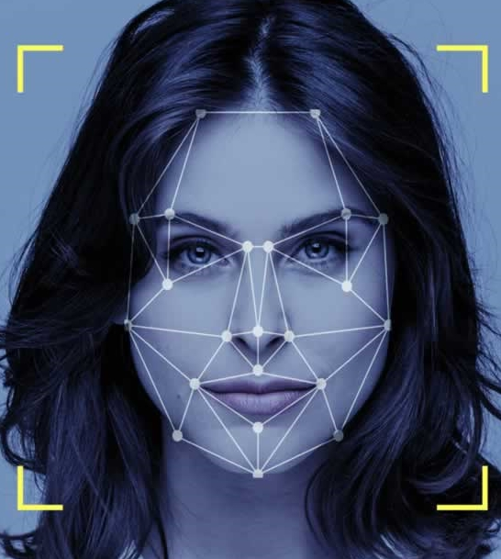
APPROACH
Sensors
Face Detection
Feature Extraction
Classification
Output

Slide 8

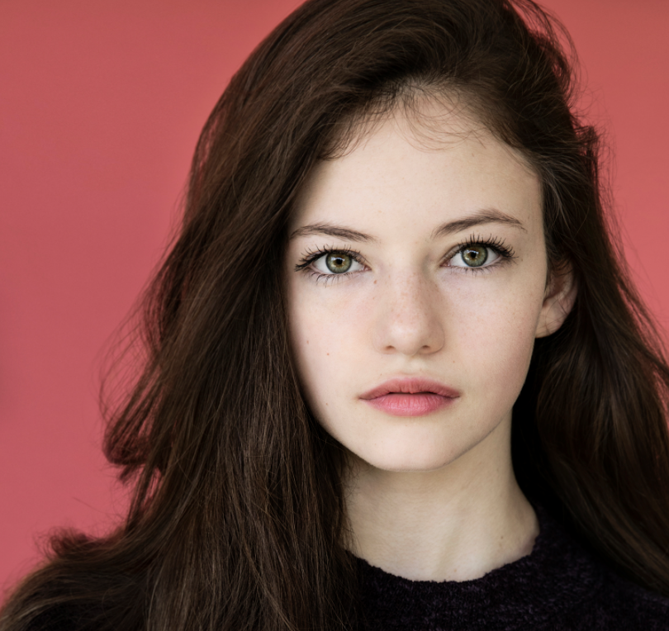
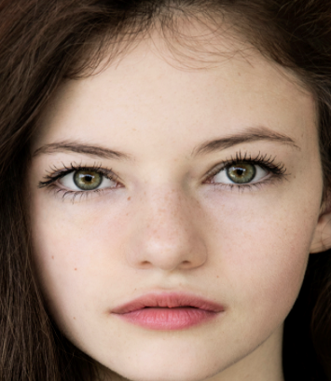
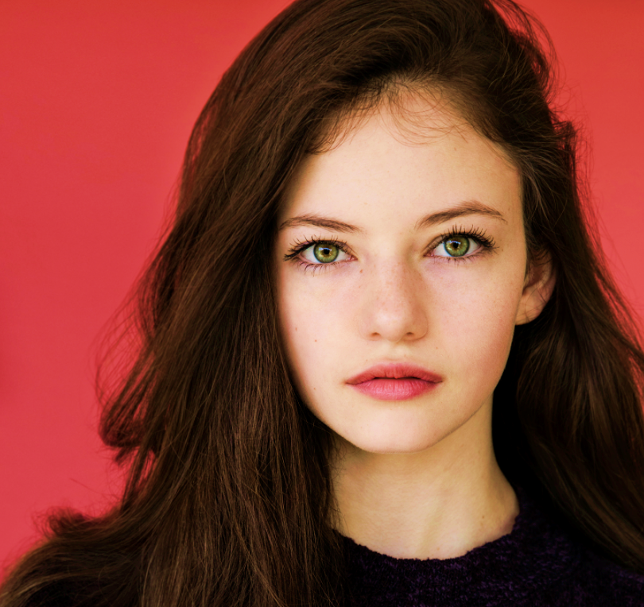
Convolution Neural Network
Age
Gender
Input Image
Convolution Layer + max pooling layer
Fully connected layer

Slide 9


METHODOLOGY
A large labelled dataset is usely divided into two parts with a ratio of 75 % and 25% which is used for training and testing the model respectively.
After this process if the accuracy level is not up to the mark you can re-train with more data or add multiple models.

Slide 10
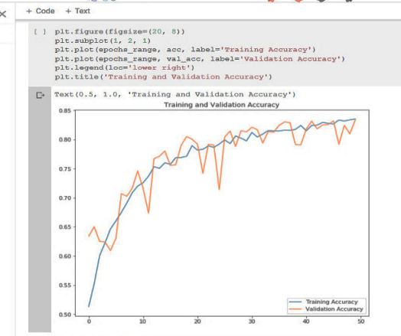
After training and testing the model to find out the accuracy level we plot a graph of both trained and test result.
We got an accuracy of 80.4% which is good.

Slide 11





TECHNOLOGIES
Front End
Back End
HTML
BOOTSTRAP
PYTHON
DEEP LEARNING API
Framework
DJANGO
KERAS

Slide 12
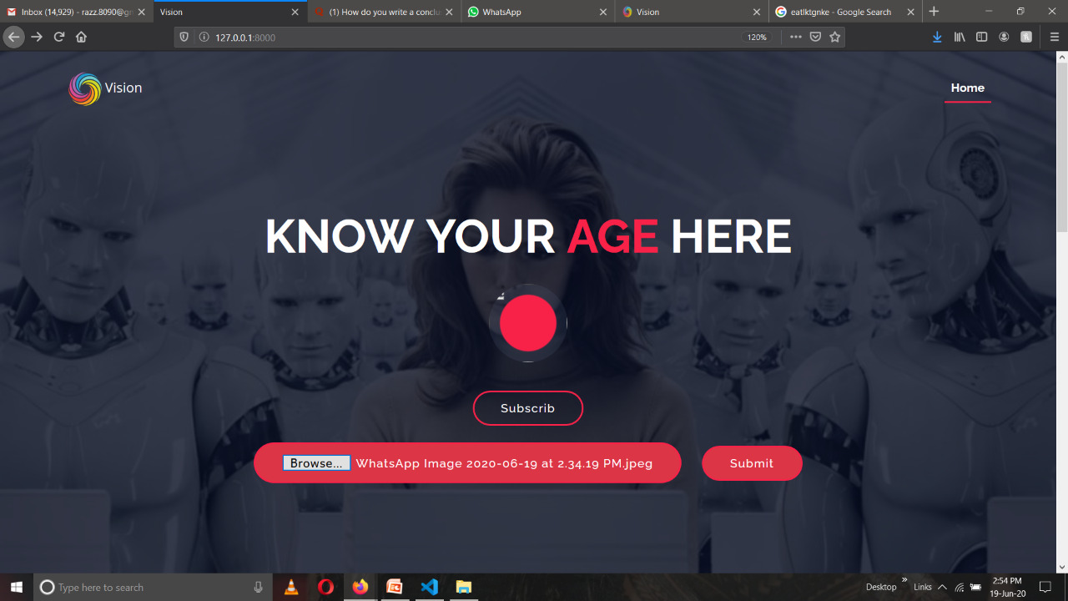
A VIEW OF THE PROJECT

Slide 13
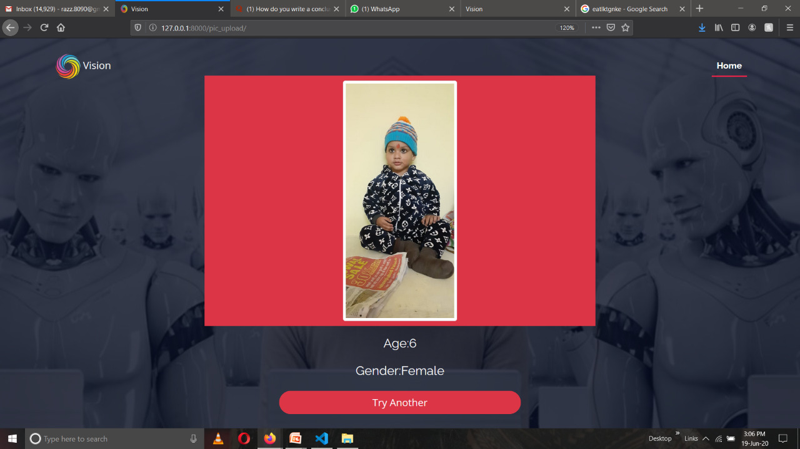
Output

Slide 14
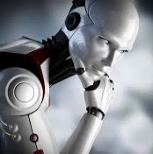
SCOPE IN FUTURE
The project has a vast scope in present scenario and future.
It can be further extended with a detection of emotion and can be used in computer vision enabled robots.
Can be extended to have a detection of mask on the persons face.
Useable in different platforms.

Slide 15
APPLICATION
It can be used at places where entry is restricted up to a certain age like movie halls, gym, zoo, pubs, swimming pools, playgrounds etc.
It can be used by various beauty camera application providers to predict the age and gender and accordingly provide the suggestions.
Some hospitals have a computer based slip issuing system. The application can be beneficial there for allotting the slip and suggesting doctor based on age and gender of the patient.
It has a great Scope in security systems both at home or professional level.
It can be used in websites, applications and game for age verification process.

Slide 16

LIMITATIONS
01
This is not useful for multiple faces at same time.
02
People tend to hide their age. Accessories worn could make it worse to detect the correct age.
03
The age detected would be an approx. one.

Slide 17
Conclusion:
We have successfully created an web application for age and gender detection using python.

Slide 18

Our Team
Raj Kumar 1605310030
Nisha 1605310025
Rohit Kumar Patel 1605310033

Slide 19

THANK YOU

